Slide 1
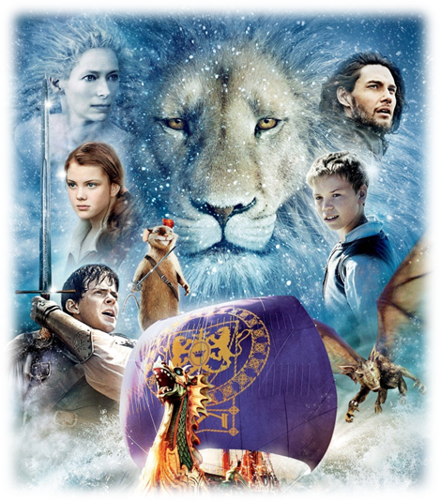
The Voyage of the Dawn Treader
Marianne Dyogi, Dora the Explorer,
Kali Damien Dyogi

Slide 2
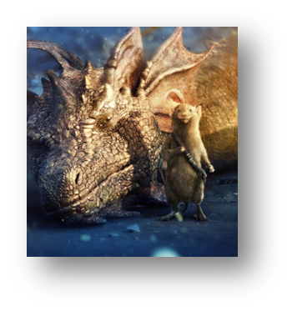
Main Conflict
Eustace vs. Himself
TYPE: Character vs. Self
Eustace is a spoiled little boy who thinks he is better than everyone else. Lazy and selfish, he tries to get out of doing work when the Dawn Treader lands on Dragon Island. He finds a dying dragon and the dragon’s lair that is filled with treasures. Eustace falls asleep and wakes up as a dragon because of his greed and selfishness. As a dragon, he realizes how horrible he was to his cousins and he feels so bad about his behavior.

Slide 3
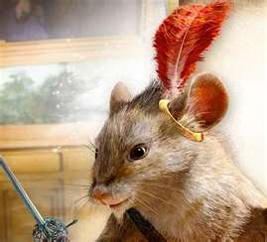
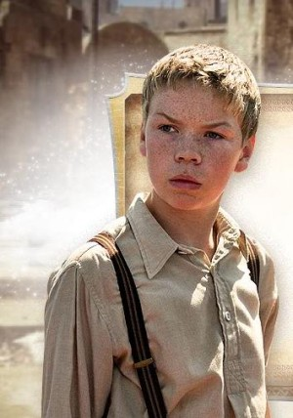
Minor Conflict #1
Reepicheep vs. Eustace
TYPE: Character vs. Character
Eustace was really getting on Reepicheep’s nerves. He thought it would be funny to pick up Reepicheep by the tail and start swinging him around. Reepicheep, on the other hand, got very angry and drew his sword challenging Eustace to a duel. Eustace didn’t want to fight the mouse, but the whole crew took the idea of a duel seriously. Eustace and Reepicheep finally became friends when Eustace was turned into a dragon.

Slide 4
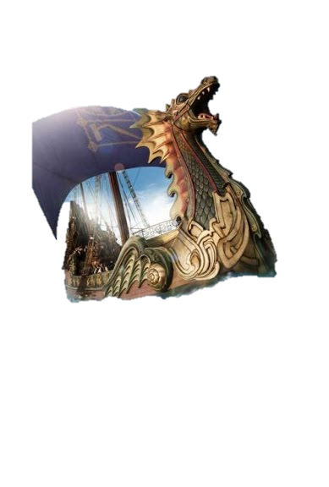
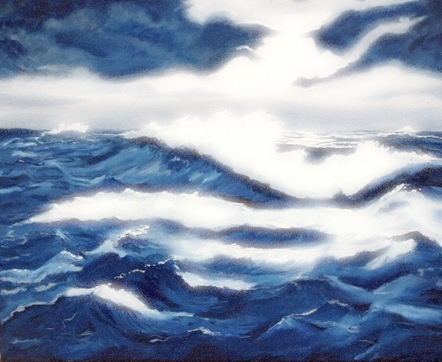
Minor Conflict #2
The Crew vs. The Great Storm
Character vs. Nature
There was a great storm in Chapter 6 that almost sank the Dawn Treader. Everyone thought they were going to die. The rain and the torturous waves went on for thirteen days and nights. No one could cook or dry themselves. One of the sailors was even lost at sea.

