Slide 1
Weather& CLIMATE
Objective:
I can describe and compare the sources of water.
I can describe the three forms of water and the processes involved in the water cycle.

Slide 2
Water moves all around If you were on a spaceship looking down at earth, you would see that most of the earth is covered by water.
Almost water on Earth is in the oceans,. Ocean water is salt water, which contains salt, of course! It is too salty for us to drink. However, many life forms live in salt ware.
Only a tiny part of earth’s water is fresh water. Fresh Water has very little salt in it. We need fresh water to drink. Many Plants and Animals need fresh water, too. Rivers and lakes contain fresh water, but most of earth’s fresh water is frozen!

Slide 4
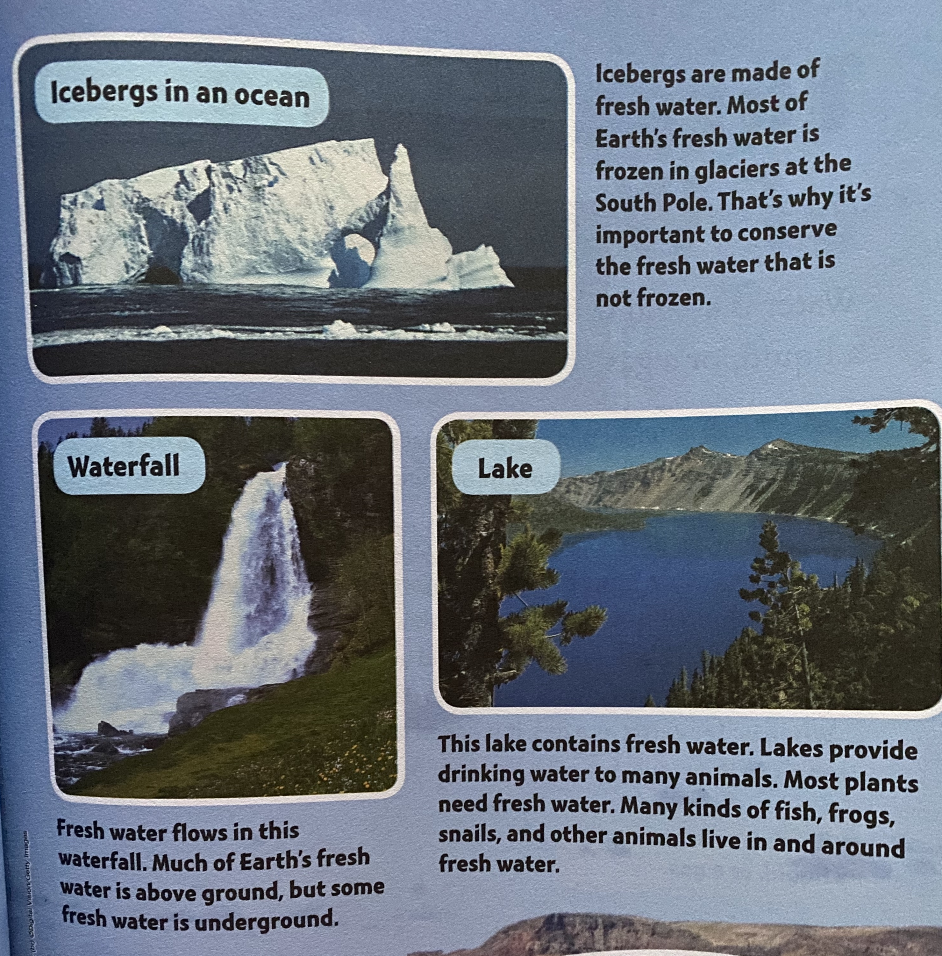

Slide 5
Three Forms of Water Water is a kind of matter. It can exist as a solid, a liquid, or a gas.

Slide 6
Changing STATES Water changes states. For example, liquid can change to ice and water vapor.
Water changes state when it is heated or cooled. When enough heat is added to ice, it becomes liquid water. This change of state is called melting. The reverse of melting is freezing.
When liquid gains enough heat, it evaporates to become water vapor. Evaporation is the change of state from a liquid to a gas.
When Water Vapor loses enough heat, it changes back to liquid water. The change of state from a gas to liquid is called condensation.
Condensation and evaporation are opposite processes.

Slide 7
THE WATER CYCLE water is always moving. In fact, water moves continuously from earth’s surface to the atmosphere and back to the earth.
Click the links to watch the Video.
https://www.youtube.com/watch?v=y5gFI3pMvoI
https://www.youtube.com/watch?v=TWb4KlM2vts

