Slide 1
First Grade Block Schedule S.Y. 2020-2021 Distance Learning (Zoom)
Time | Monday | Tuesday | Wednesday | Thursday | Friday
8:30-9:00am | Morning Meeting Religion/Journal Writing | Morning Meeting Religion/Journal Writing | Morning Meeting Religion/Journal Writing | Morning Meeting Religion/Journal Writing | Mass
9:00-10:00 am | Math | Math | Math | Math | Arts
10:00-10:30am | Snack Time
10:30-11:00 | Word Study | Word Study & Fluency | 10:30-11:00am Word Study & Fluency | Word Study | Word Study & Fluency
11:00-11:30 | FLUENCY | READING |  | FLUENCY | READING
 |  |  | 11:00-11:30am PE
11:30-12:00 | GRAMMAR | HANDWRITING |  | GRAMMAR | SMALL GROUP/ WIN TIME GROUP A & B
12:00-1:00pm | LUNCH
1:00-2:00pm | 1:00-1:30 SOCIAL STUDIES | MUSIC | 1:00-1:30 WIN TIME | 1:00-1:30 SCIENCE | 1:00-1:30 SMALL GROUP/ WIN TIME GROUP C & D
 | 1:30-2:00 HANDWRITING |  | NOON DISMISSAL | 1:30-2:00 HANDWRITING | 1:30-2:00 SEESAW ACTIVITIES
2:00-2:30 | Independent Work / Homework Time

Slide 2
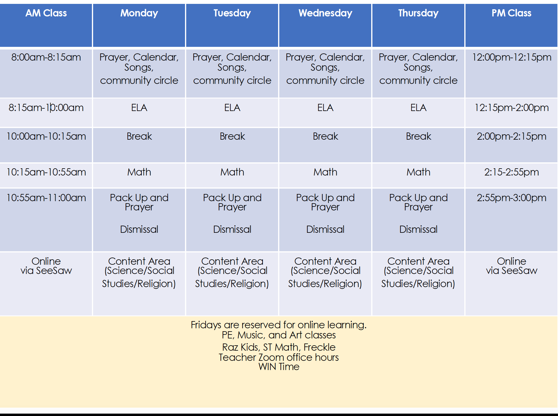
First Grade Block Schedule S.Y. 2020-2021 Hybrid AM/PM

